Slide 1
Geospatial data application in economics
Songyan Zhu

Slide 2
Interactive Q (on menti)
Your experience of using geospatial (or what do you know about it)

Slide 3
1. What is geospatial
Definition: data that describes locations on Earth
Raster: Made up of a grid of pixels (cells) e.g., satellite imagery, made up by pixels, where each pixel has a specific value representing information like air pollution
Vector: Composed of geometric shapes (points, lines, and polygons) defined by coordinates.
Point clouds: e.g., LiDAR 3D modelling

Slide 4
1.1 Exmaples
[Placeholder] Show a Sentinel-2 image of Exeter
[Placeholder] Show a shapefile of LSOA

Slide 5
1.2 Difference between rasters and vectors
Aspect | Raster | Vector
Data Type | Continuous | Discrete
Representation | Grid of pixels | Points, lines, polygons
File Size | Can be large (high-res images) | Smaller, depends on complexity
Precision | Limited by pixel size | High precision at any scale
Best For | Terrain, remote sensing, environmental data | Infrastructure, administrative boundaries, navigation

Slide 6
Qs
Any questions?
What would you prefer to use in your work, give some examples

Slide 7
2. How to access geospatial data
Google it… Every data provider has their own data distribution source/website

Slide 8
2.1 Not smart but most used sources
Raster (many are free, not all supporting batch download well):
NASA Earth Data (https://www.earthdata.nasa.gov/)
USGS (https://earthexplorer.usgs.gov/)
ERA5 (https://cds.climate.copernicus.eu/datasets/reanalysis-era5-land?tab=download)
ESA portal (https://earth.esa.int/eogateway)
Vector – more dispersed, go to local authorities or global organisations (not always free of charge):
UK gov (https://geoportal.statistics.gov.uk/)
World Bank (https://datacatalog.worldbank.org/search/dataset/0038272/World-Bank-Official-Boundaries)
Google Earth (https://earth.google.com/web)

Slide 9
2.2 Not perfect but a convenient way
Google Earth Engine (https://earthengine.google.com/)
Interactive cloud-based geospatial analysis platform
Limited customisation, local processing, and commercialisation

Slide 10
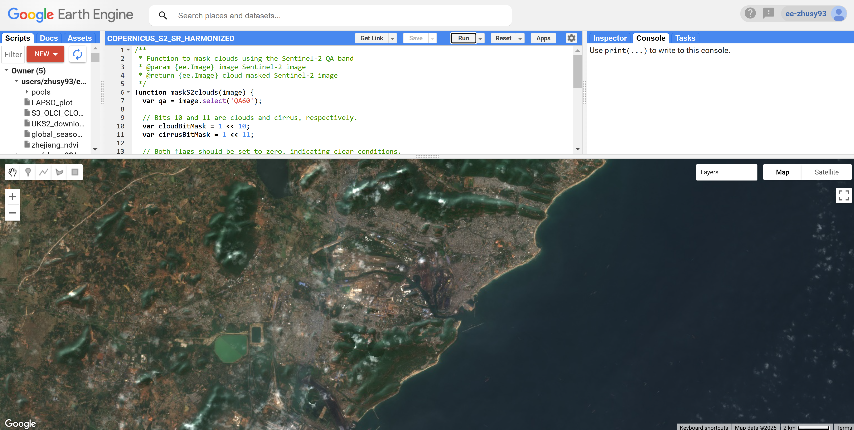
2.2 Example of GEE
[Placeholder]

Slide 11
2.3 Practice
Register Google Earth Engine and start a project to play with it.

Slide 12
Qs
Any questions?
What are the challenges for you to use geospatial now

Slide 13
3 My trick to access geospatial data
Fetch GEE data to local or preferred cloud computing and process there
What I use: Python and Google Colab
Python: a modern and ‘easy’ programming language
Google Colab: https://colab.research.google.com/notebooks/intro.ipynb, an online Python & R programming notebook platform

Slide 14
3.1 Python intro

Slide 15
3.2 Notebook intro

Slide 16
3.3 GitHub and package installing

Slide 17
Qs
Any questions?
Would you like to use online or local environment?

Slide 18
4. Get and load data
scigee and scitbx
Download time series for one locations
Download geospatial

Slide 19
4.1 What you need
Option A:
Register Google Colab (free) and you need to authorise its access to Google Drive (15 GB free) – you can register a new google account
Option B:
Install Python Anaconda locally
Install gee package (pip install earthengine-api)
Run notebook on your machine

Slide 20
4.2 Data format
Raster
Geotiff
NetCDF
Vector:
Shapefile
geojson
geopackage

Slide 21
4.3 Data loading solutions
Softeware:
ENVI, ArcGIS, QGIS etc. – expensive and normally for single file
Python packages:
Geopandas (Fionna)
Rasterio (GDAL)

Slide 22
4.4 Download satellite image
Use scigee to download time series

Slide 23
4.4 Download satellite image
Use scigee to download geospatial

Slide 24
4.5 Download climate
Use scigee to download time series

Slide 25
4.5 Download climate
Use scigee to download geospatial

Slide 26
4.6 Load time series
Pandas

Slide 27
4.7 Load geospatial
Scitbx xarray rioxarray

Slide 28
4.8 Load vector – points, lines, and shapes
geopandas

Slide 29
4.9 Some geo processing
Geopandas
Closest point
Area
Centroid

Slide 30
4.10 Some geo processing
Reproj
Resampling
Gap-filling

Slide 31
Qs

Slide 32
5 Analysis
OLS
ML
Causal
Maybe air pollution impacts on some econ variables? @Xiaohui

Slide 33
5.1 Analysis (Xiaohui provides some econ data and example)
OLS

Slide 34
5.2 Analysis (Xiaohui provides some econ data and example)
ML

Slide 35
5.3 Analysis (Xiaohui provides some econ data and example)
Bayesian causal inference

